Slide 1

Group 5 Modeling Songs to Predict Release Year

Slide 2
General description of the dataset
The "Year Prediction MSD" dataset consists of 515,345 musical tracks and 90 musical features for each track. The goal of the dataset is to predict the year of release of a musical track based on these audio features.
The general properties of the dataset include:
Size: 515,345 musical tracks and 90 features for each track
Data format: comma-separated values (CSV) text file
Variables:
Year: year (target), ranging from 1922 to 2011.
Features: 90 attributes, 12 = timbre average, 78 = timbre covariance
Data types:
Year: numerical (integer)
Features: numerical (float)

Slide 3
General description of the dataset
Data Set Information from the webpage:
You should respect the following train / test split:
train: first 463,715 examples
test: last 51,630 examples
It avoids the 'producer effect' by making sure no song from a given artist ends up in both the train and test set.
Task: Modelling Songs to Predict Release Year:
investigate suitable classification methods for the task
offer comparative results along with an analysis of the results

Slide 4
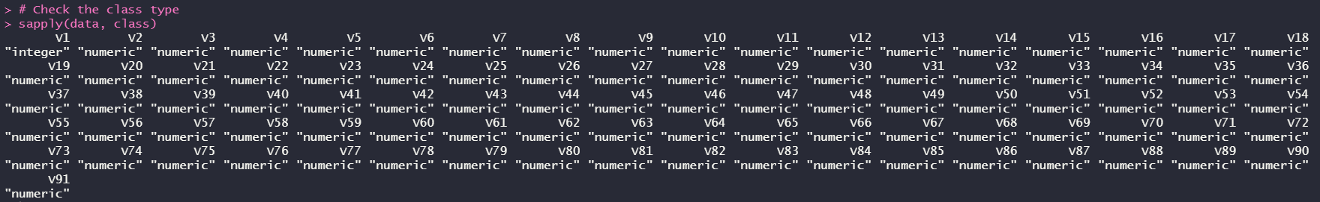
Data Pre-processing
Check for class types
In music, timbre also known as tone colour or tone quality is the perceived sound quality of a musical note, sound or tone. Timbre distinguishes different types of sound production, such as choir voices and musical instruments.
Both the timbre average and the timbre covariance are important features for music analysis and can be used as inputs for machine learning models to predict the release year of a music recording.

Slide 5
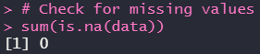
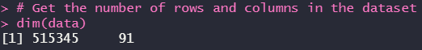
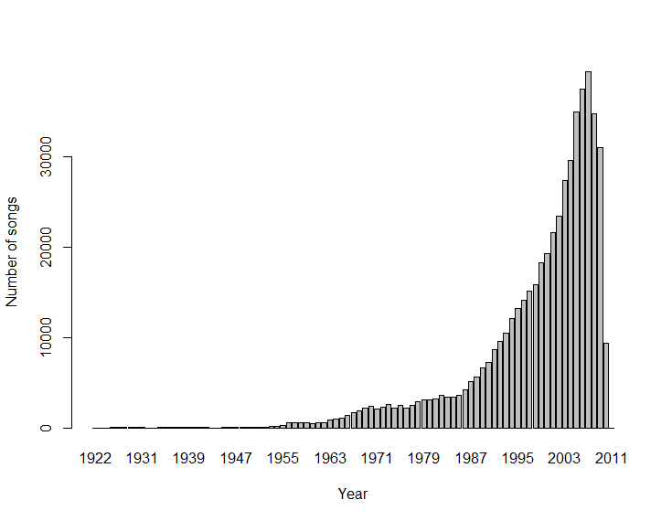
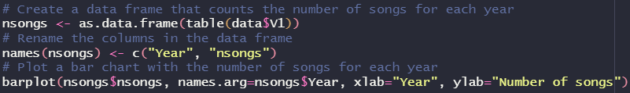
Data Pre-processing
Check for missing values
Get the number of rows and columns in the dataset
Number of records per year

Slide 6
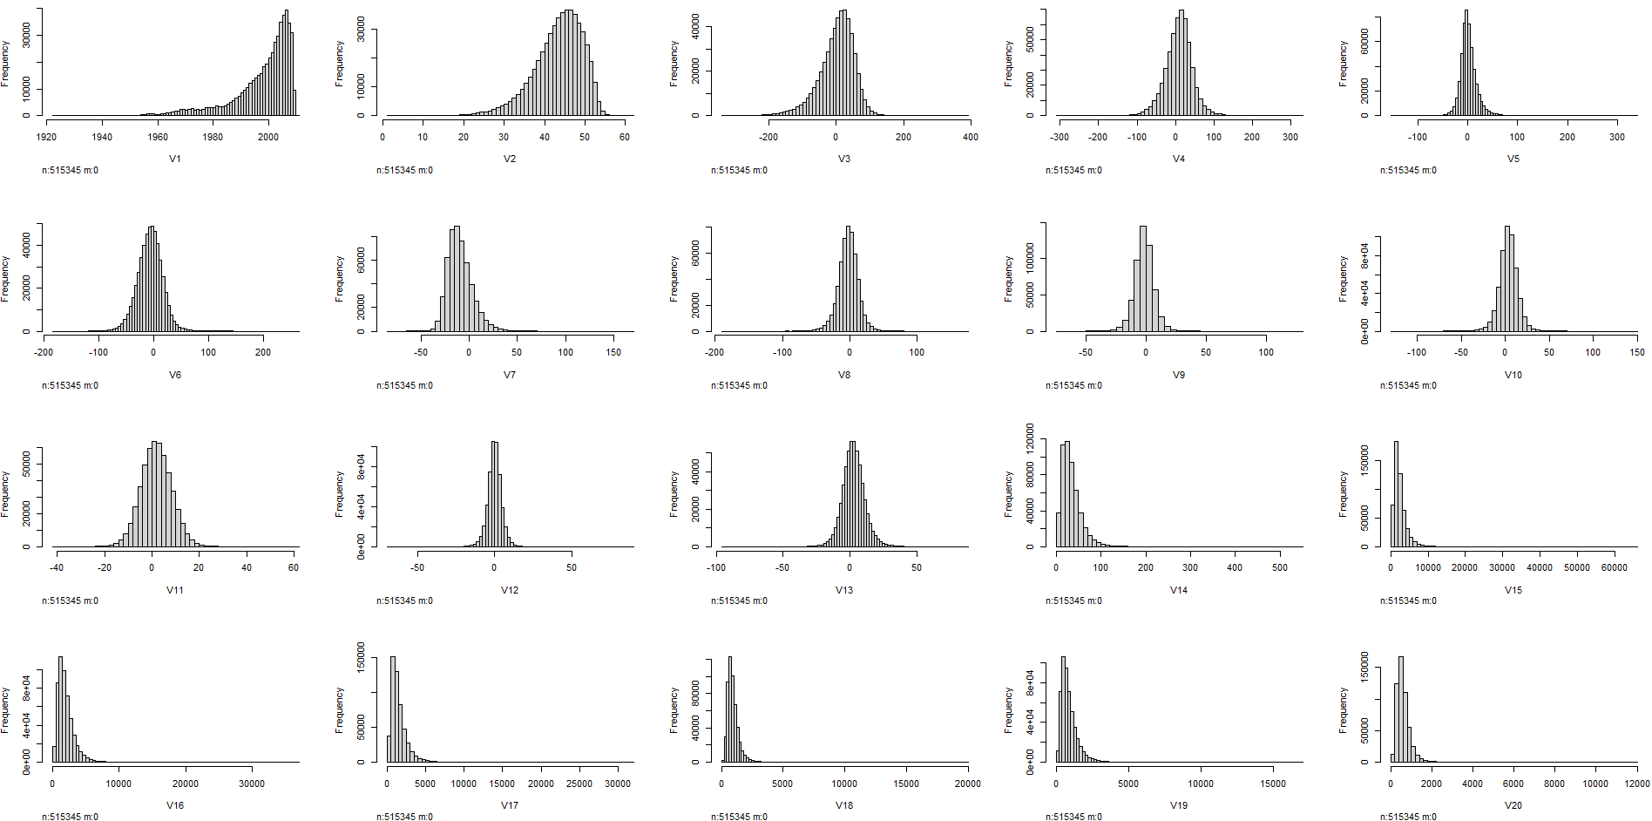
Data Pre-processing
Histogram of the variables (first 20 variables)

Slide 7
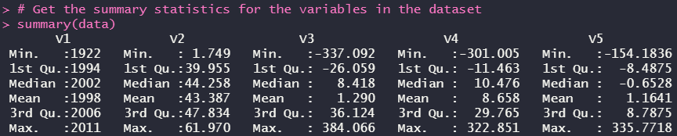
Data Pre-processing
Summary (first 5)
The spread of data of each column is too huge. There might be outliers potentially.

Slide 8
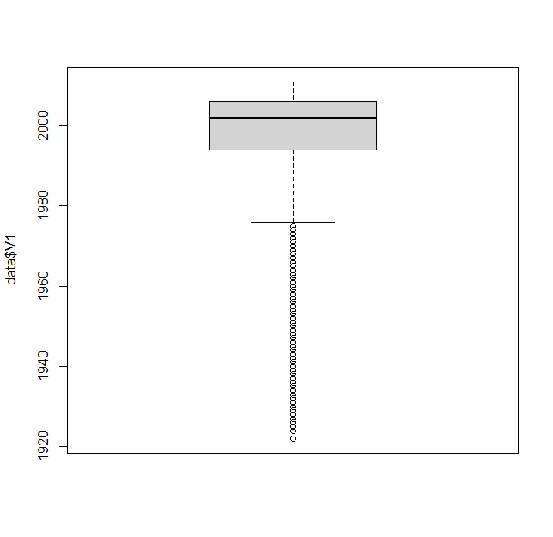
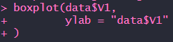
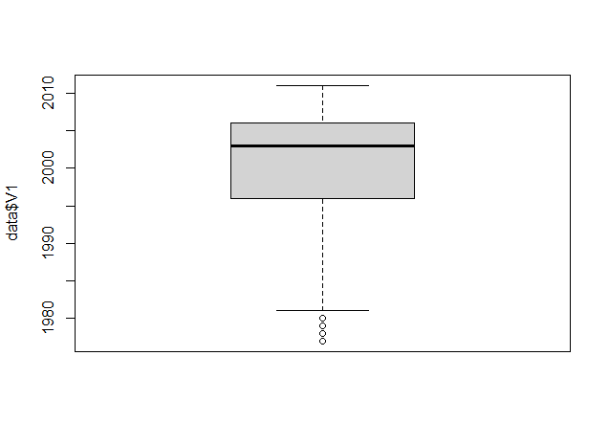
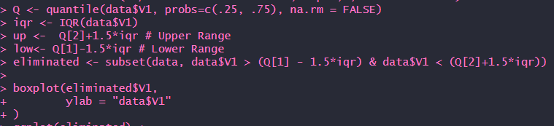
Data Pre-processing
Plot to show outliers
Corusing the interquartile range (IQR) method. It calculates the first and third quartiles, then calculates the IQR, and uses it to determine the upper and lower ranges for outliers.

Slide 9
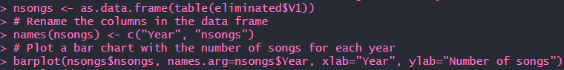
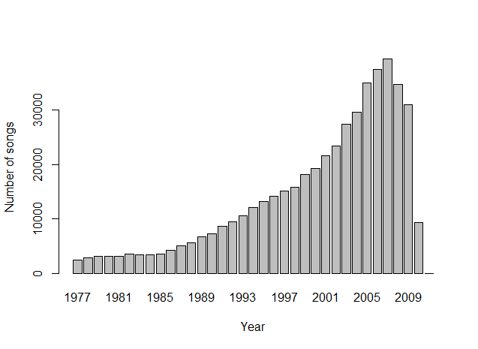
Data Pre-processing
After removing outliers

Slide 10
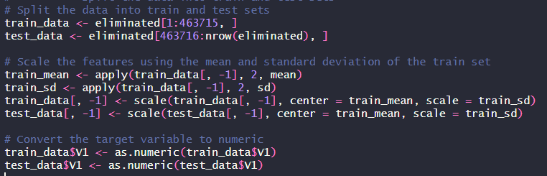
Data Pre-processing
Split the data into train and test sets

Slide 11
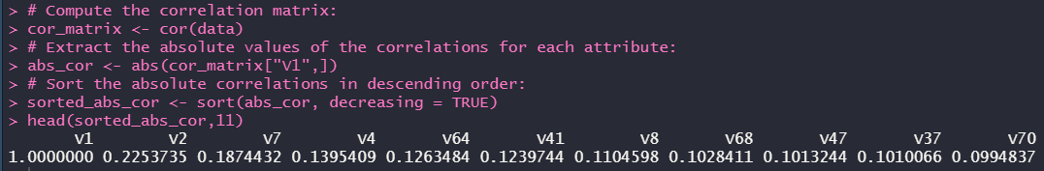
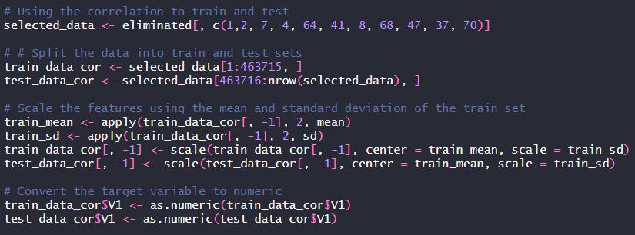
Data Pre-processing
Correlation
Checking for top 10 highest correlation presented in descending order corresponding to target variable V1

Slide 12
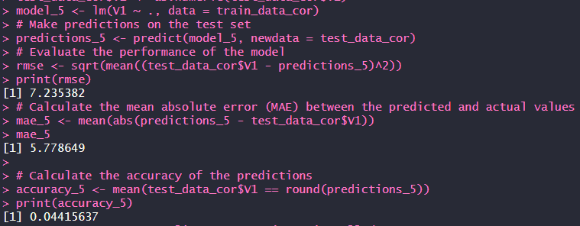
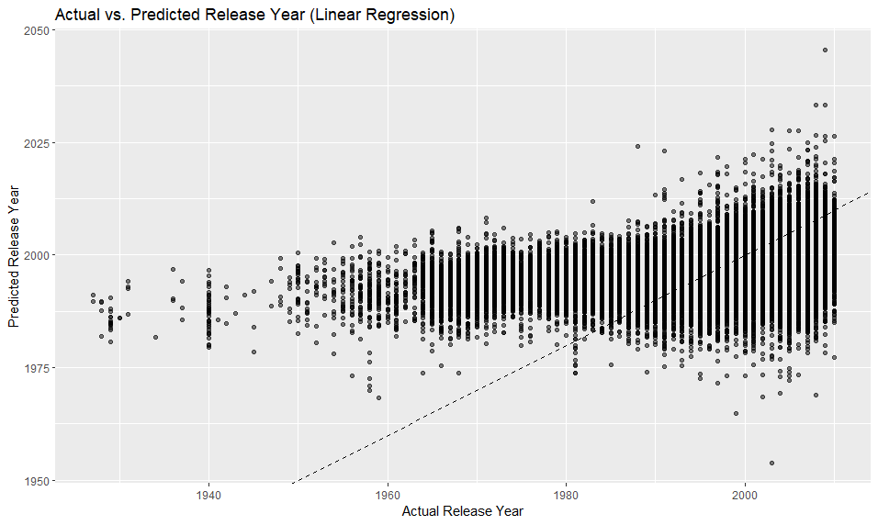
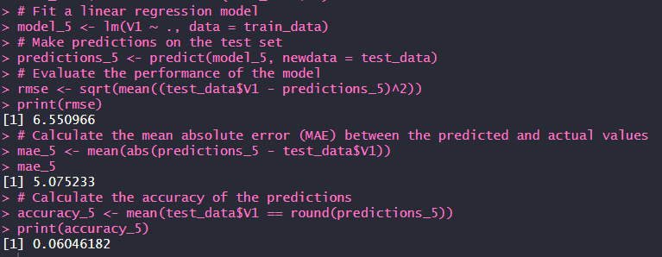
Proposed data mining approach and methodology
Training using linear model
Using top 10 correlation
Linear model plot
Using all the variables

Slide 13
Proposed data mining approach and methodology
Training using linear model
Strengths of the proposed approach using linear model:
Linear regression is a simple and interpretable model that can capture linear relationships between the input features and the target variable.
The model can make reasonably accurate predictions of the target variable based on the input features.
The performance of the model can be evaluated using metrics such as RMSE, MAE, and accuracy.
Weaknesses of the proposed approach using linear model:
The model assumes a linear relationship between the input features and the target variable, which may not always be the case.
The model may not capture complex nonlinear relationships between the input features and the target variable.
The model may be affected by outliers and influential observations in the dataset.
The model's performance may be limited by the quality and quantity of the input features available.

Slide 14
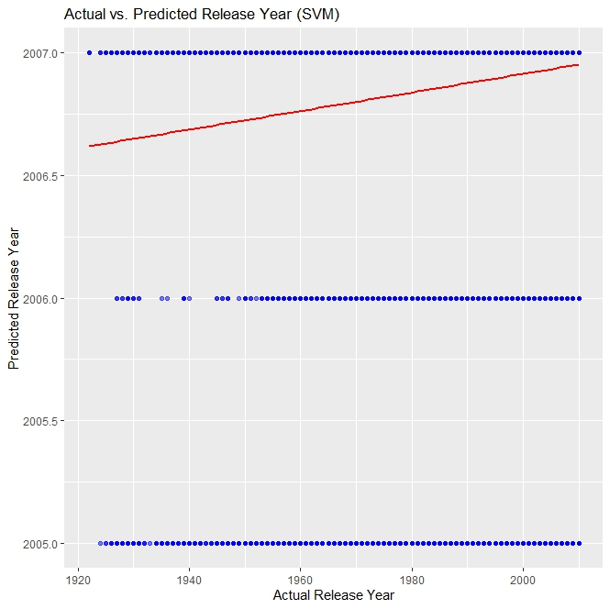
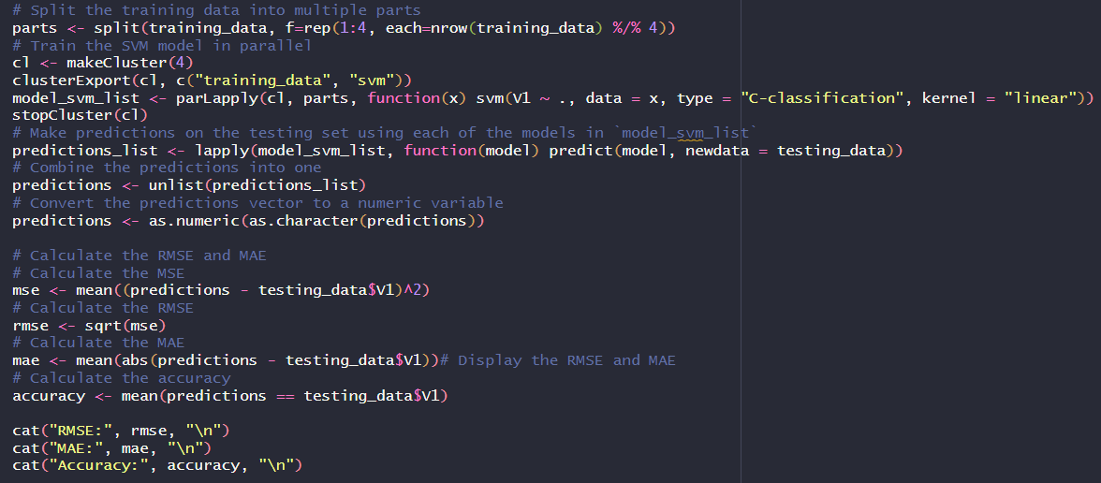
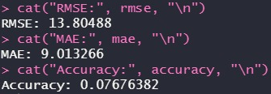
proposed data mining approach and methodology
Training using SVM model

Slide 15
Proposed data mining approach and methodology
Training using SVM model
Strengths of the proposed approach using SVM model:
Effective for high-dimensional data with a clear separation between classes
Robust to outliers
Can handle non-linear relationships between features and target using kernel functions
Weakness of the proposed approach using SVM model:
Can be sensitive to the choice of kernel function and hyperparameters
Slower to train and make predictions compared to linear models
Less interpretable than linear models

Slide 16
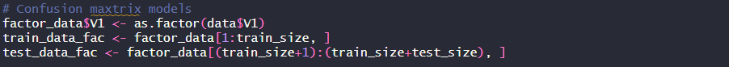
Alternative approach
Year is considered a categorical variable because it represents a qualitative rather than quantitative aspect of the data. In other words, the year has no mathematical significance in its ordering, and each year is unique and different from others. When using regression analysis, categorical variables are often encoded as dummy variables, which are binary variables that represent the presence or absence of a particular category. This allows you to use regression techniques to analyze the relationship between the categorical variable and other variables in the dataset.
Confusion matrix
Matrix function provides a detailed view of model performance.
It helps to identify where the model is making errors.
The matrix provides the number of true positives, true negatives, false positives, and false negatives.
These metrics can be used to calculate performance metrics such as accuracy, precision, recall, and F1 score.
The metrics help to better understand the model's strengths and weaknesses and how it performs on different subsets of data.
By using a confusion matrix, we can obtain a better picture of how well the model is performing and take steps to improve it if necessary.

Slide 17
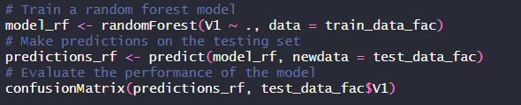
Random forest model, confusion matrix
Alternative approach
The model is a binary classification model, and the accuracy metric is being used to evaluate its performance.
The model's overall accuracy is 0.1436, meaning that it is correctly classifying only 14.36% of the test instances.
The No Information Rate (NIR) is 0.0758, which is the accuracy that could be achieved by always predicting the majority class, and the model's accuracy is statistically significantly better than the NIR.
The Kappa statistic is 0.0868, indicating that the model is not doing much better than chance.
The McNemar's test P-value is not available, meaning that the test could not be performed for this model.
Overall Statistics
Accuracy : 0.1436
95% CI : (0.1419, 0.1454)
No Information Rate : 0.0758
P-Value [Acc > NIR] : < 2.2e-16
Kappa : 0.0868
Mcnemar's Test P-Value : NA

Slide 18
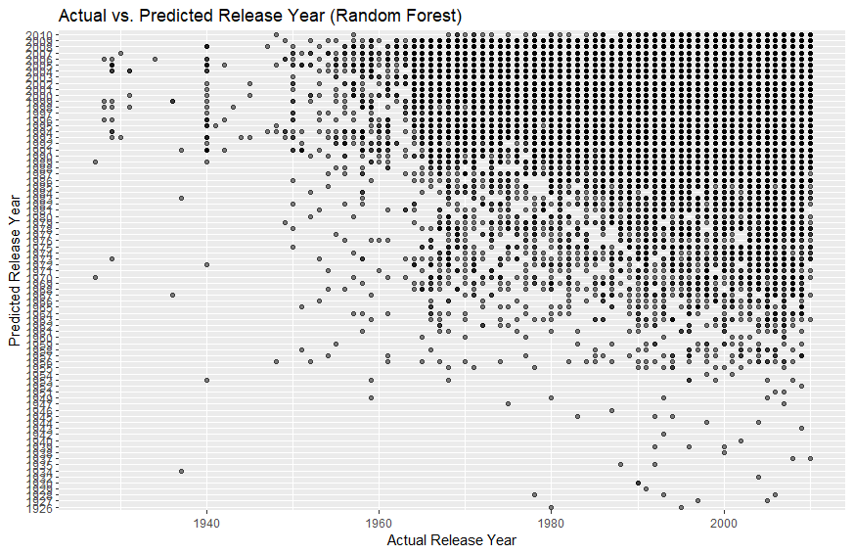
Random forest model, confusion matrix

Slide 19
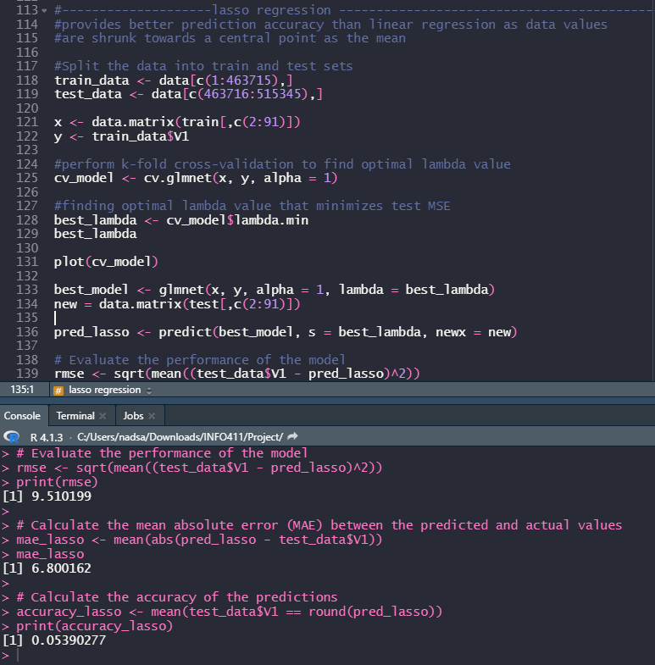
Proposed data mining approach and methodology
Training using Lasso Regression model
No tuning needed as k-fold cross validation has been used to find optimal lambda value to minimise test mean-squared error
The model's overall accuracy is 0.0539, meaning that it is correctly classifying only 5.39% of the test instances, only slightly better than using linear regression model

Slide 20
Proposed data mining approach and methodology
Training using Lasso Regression model
Strengths of the proposed approach using lasso regression model:
When there are a large number of predictors or some of the predictors are correlated, linear regression can suffer from overfitting. Lasso regression can be a better option because it includes a regularization term that encourages small coefficient values and feature selection.
Prevent overfitting and lead to better generalization performance.
Can handle high-dimensional datasets with many features, and it is particularly useful when there are many predictors that are potentially relevant but only a few are likely to be truly important.
Weaknesses of the proposed approach using lasso regression model:
Lasso may not be able to capture complex relationships between the predictors and the response variable and may underfit the data if the true relationship is nonlinear.
sensitive to outliers in the data and can produce biased estimates in the presence of outliers.

Slide 21
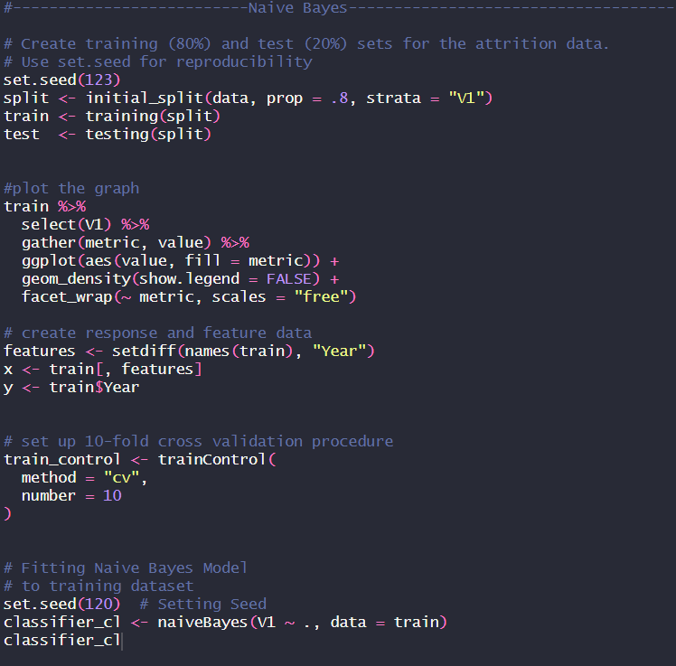
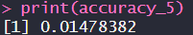
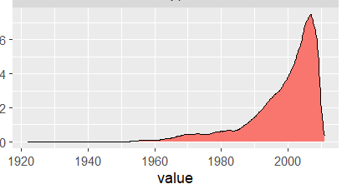
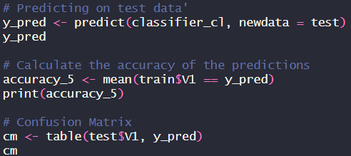
Other models attempted
Training using Naive Bayes
Used cross validation with the number of 10 fold for training data set but it shown the argument about different imply rows. Hence, only able to predict on the test data set.
The model's overall accuracy is 0.01478, meaning that it is correctly classifying only 1.48% of the test instances, only slightly better than using random forest model
As a result, the accuracy of the prediction is not good by using Naive Bayes model.

Slide 22
Other models attempted
Training using Naive Bayes
Strengths of the proposed approach using Naive Bayes:
Naive Bayes perform well on high-dimensional datasets where the number of features can be very large. It can handle thousands of features with ease and be used for feature selection and dimensionality reduction
Naive Bayes is robust to noisy and missing data because it ignores irrelevant features and can handle missing data without the need for imputation.
Naive Bayes provides interpretable results because it calculates the conditional probability of each feature given the class, which can be used to identify the most informative features and the reasons for the classification.
Weaknesses of the proposed approach using Naive Bayes:
Naive Bayes can be computationally efficient for small to medium-sized datasets, but it may not be suitable for very large datasets with millions of features or instances.
Naive Bayes can be sensitive to imbalanced datasets, where one class has significantly more instances than another class. This can lead to biased results, where the model is biased towards the majority class.
If there are strong correlations between features, then Naive Bayes may not perform well.

Slide 23
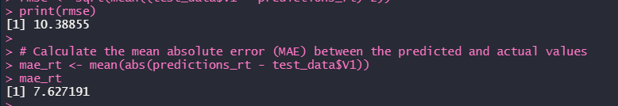
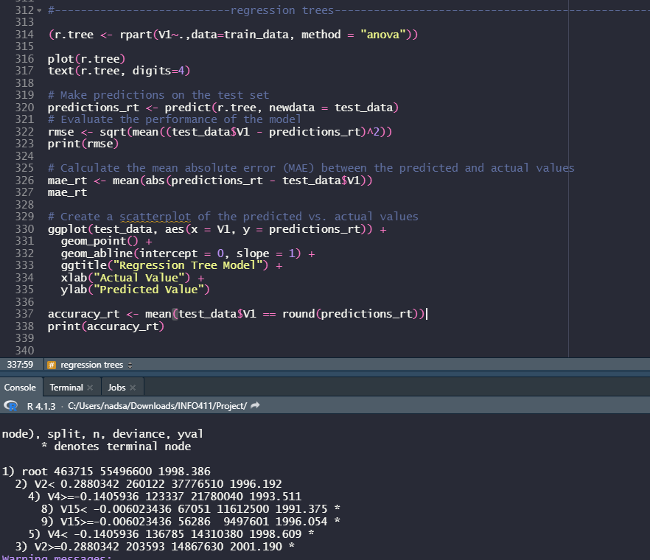
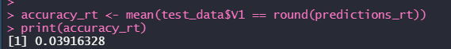
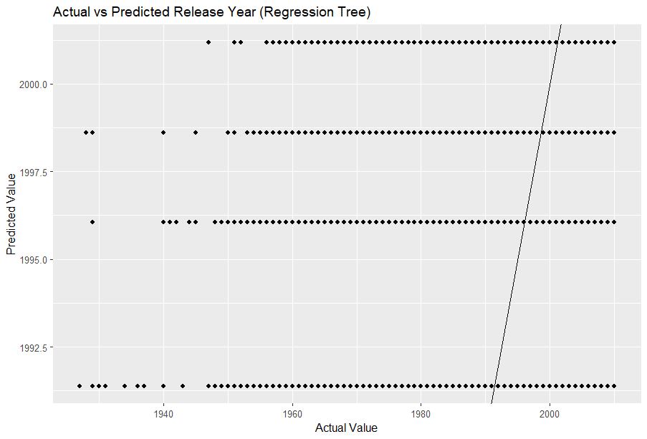
Other models attempted
Training using Regression tree model

Slide 24
Methods attempted to handle imbalanced data and improve the accuracy of the models
Remove outliers: Outliers would be able to remove extreme values that may bias the results. There was an attempt to remove outliers, however upon removal, the train test split rule (from dataset site) could not be used, so we abandoned the removal of outliers.
Scaling data: Data was scaled but did not do much to improve accuracy due to the severe imbalance of data in target column
Cross-Validation : Data having overfitting and underfitting issues to the training data which there are some non-representative data. After performing a 10 fold of cross validation based on the shuffled data from our data set, the result will be 0.
Tune Hyperparameter : The tuning method cannot handle categorical predictors with more than 53 categories . Hence, this method is not well-suited for this particular dataset.
> bestmtry <- tuneRF(data_train,data_train$V1,stepFactor = 1.2, improve = 0.01, trace=T, plot= T)
Error in randomForest.default(x, y, mtry = mtryStart, ntree = ntreeTry, :
Can not handle categorical predictors with more than 53 categories.
Most models had pure accuracy and classification due to the imbalance of the target feature. Target feature (V1) has 89 different values, whilst most target attributes usually have around 3-10 values. For example, in year 2011, there was only one record available, whereas year 2003 had around 30,000 records.
This caused the algorithms used to struggle with accuracy because of the unequal distribution in dependent variable. It also caused the performance of existing classifiers to get biased towards the majority class.

Slide 25

Can we do binary search here??
1922
1976
2011

Slide 26
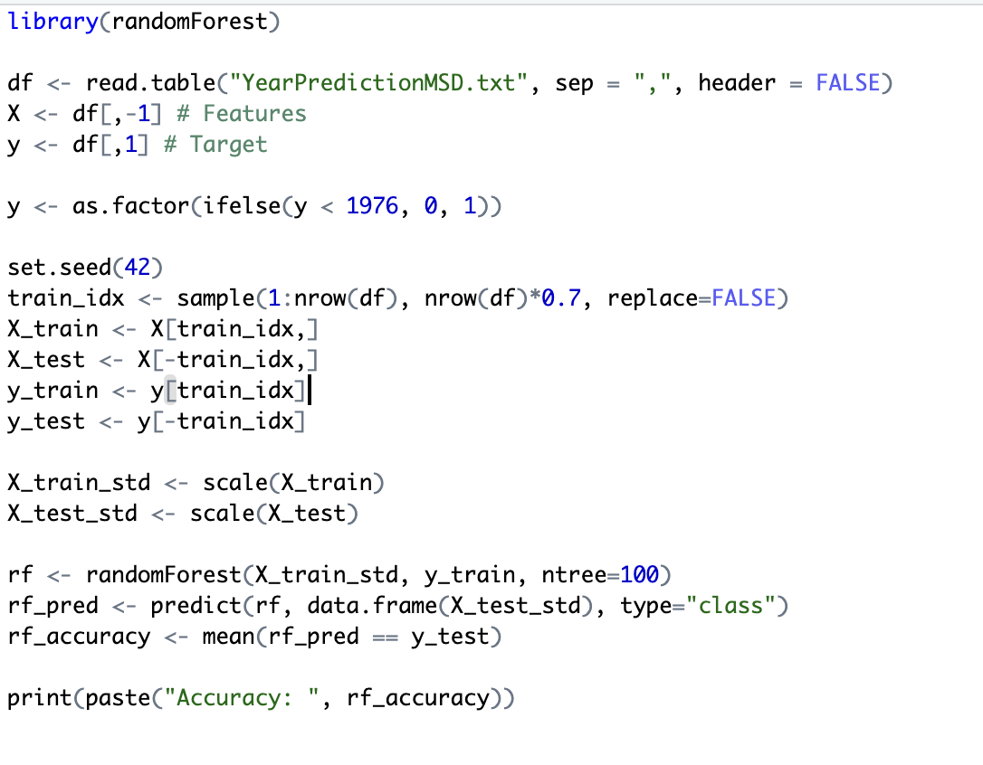
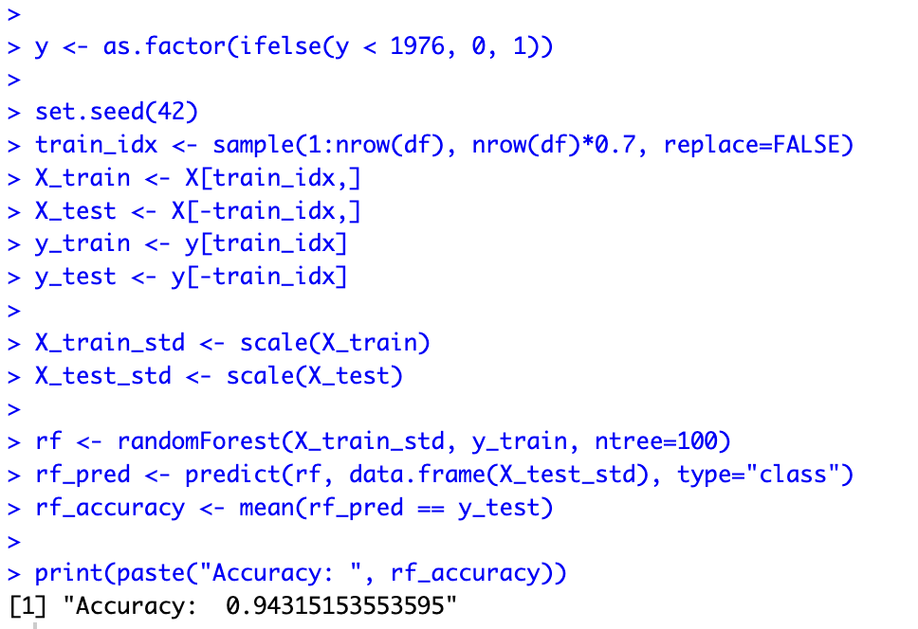

Slide 27
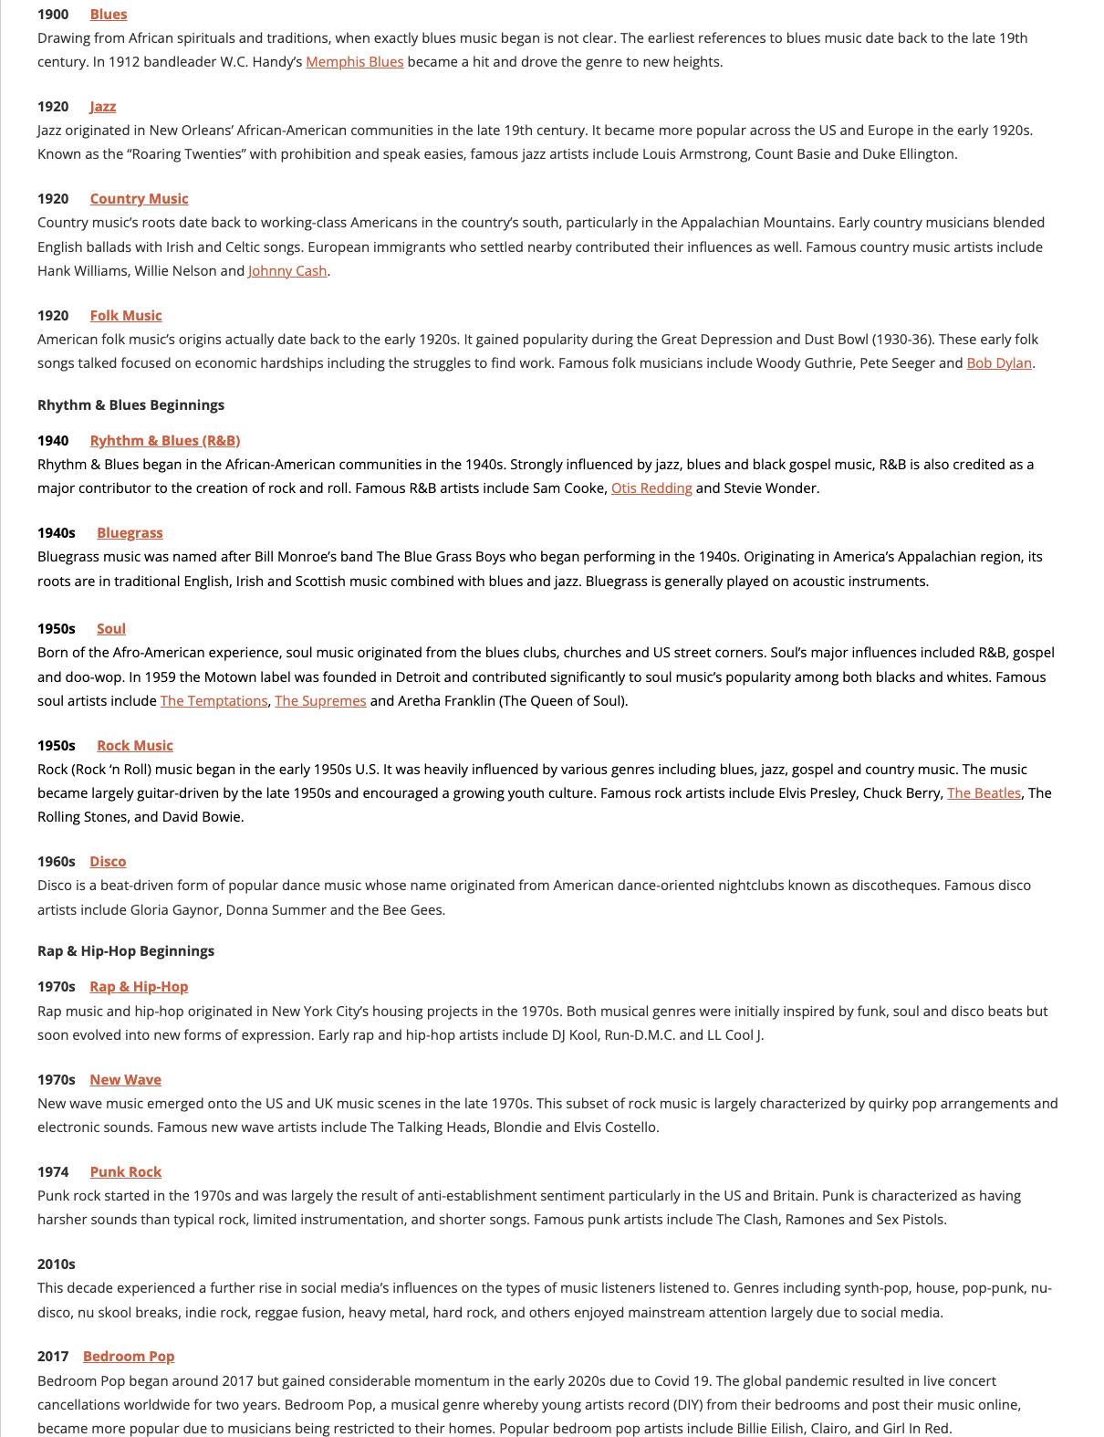
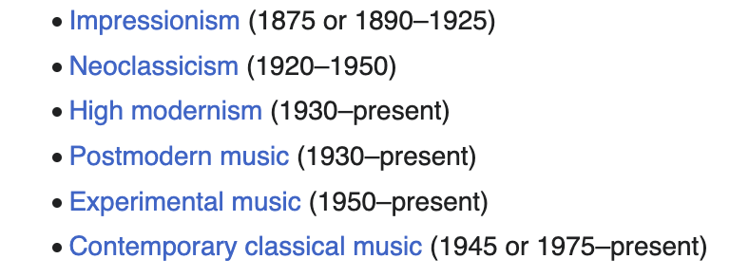

Slide 28
Cut Time
1922
1939
1957
1975
1993
2011
18 years
18 years
18 years
18 years
18 years

Slide 29
Classification
Random Forest
- Time consumed about 20-30 mins
SVM
-Time consumed about 10 hours
Decision Tree
-Time consumed about 10-20 mins

Slide 30
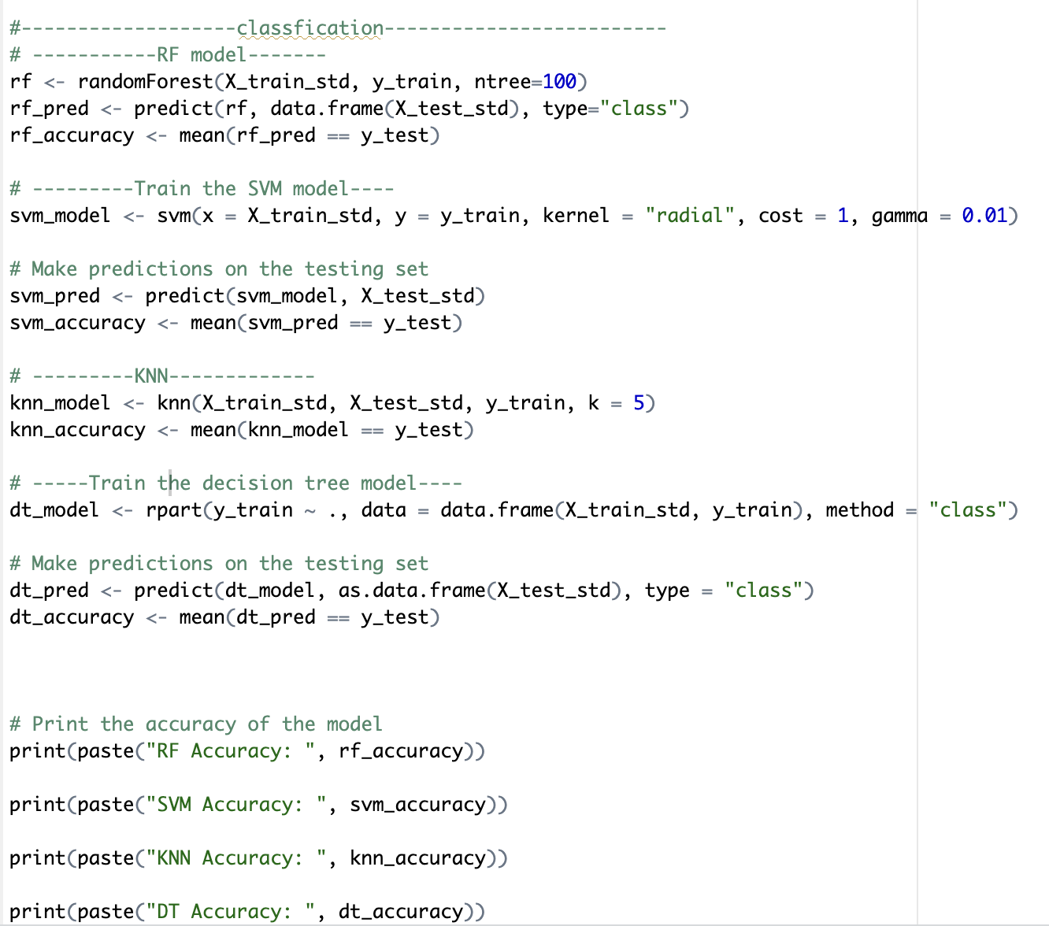
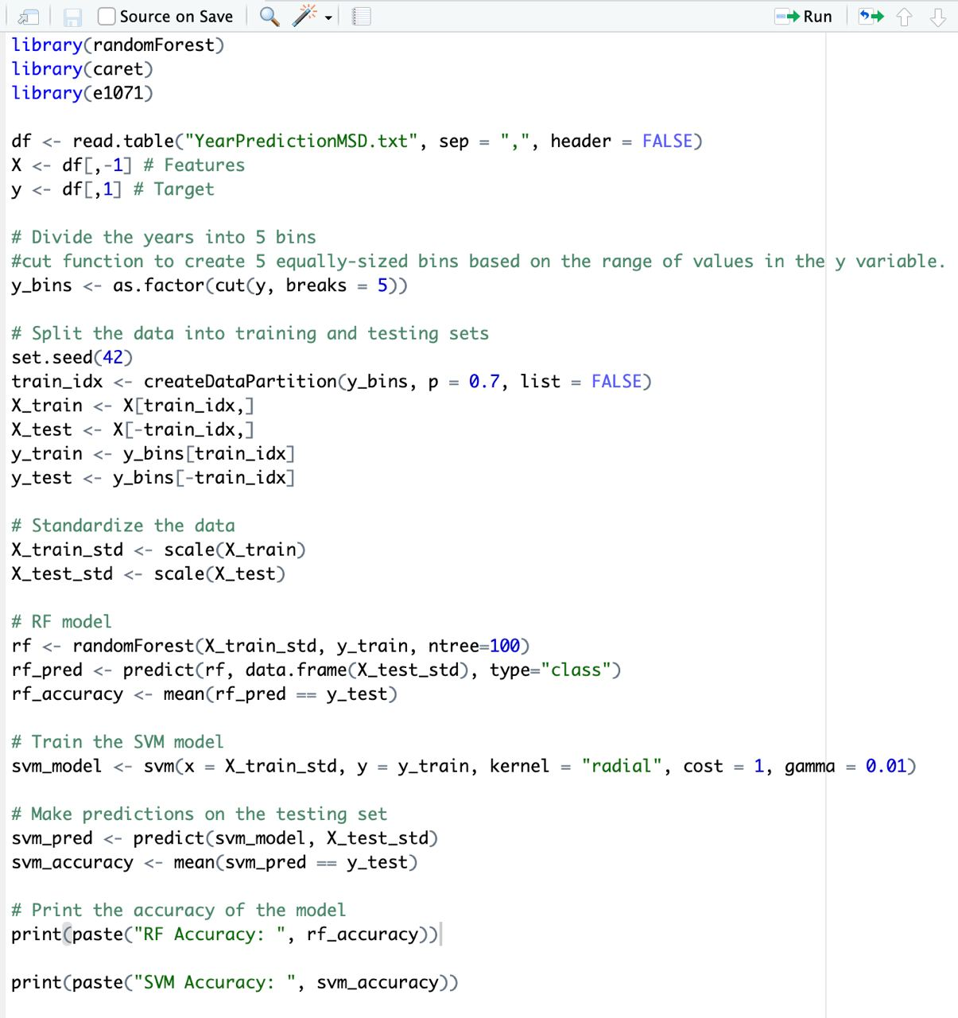
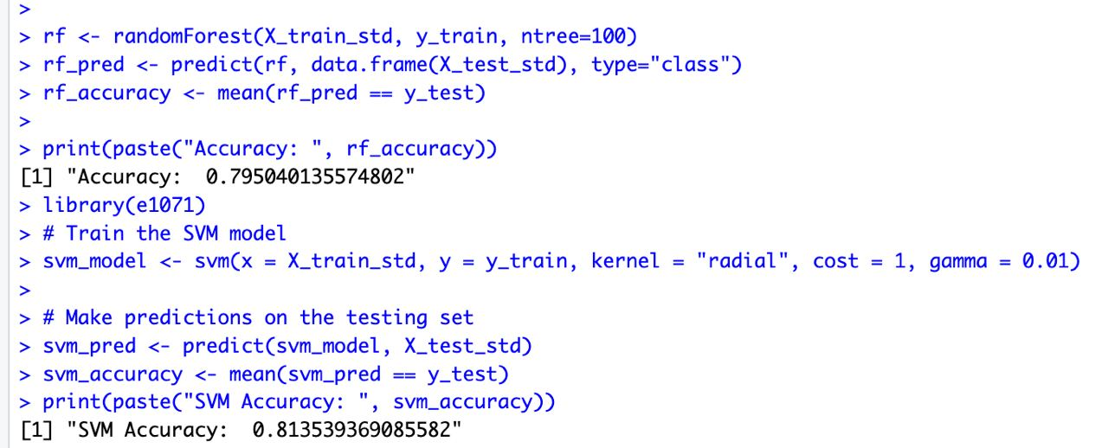
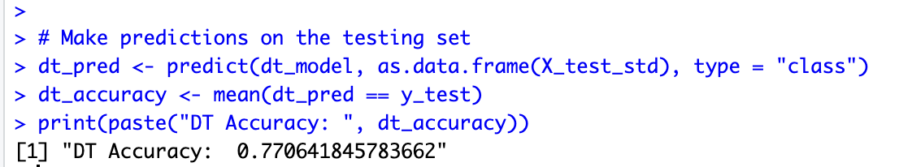
Other models attempted
Random forest and SVM Binning method

Slide 31
Sum up
 | Accuracy | Time Cosumed
Random Forest | 0.7950 | 20-30 mins
SVM | 0.8135 | 10 hours
Decision Tree | 0.7706 | 10-20 mins

Slide 32
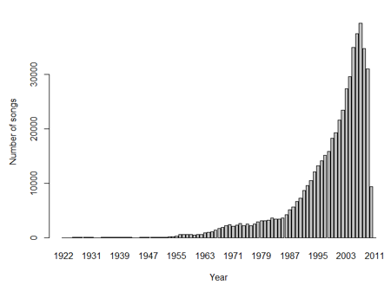
Summary
Learning points
We used clustering method which helps to distribute the workload across multiple machines. Reducing the training time by running computations in parallel on multiple machines. Lastly allowing us to make use of all cores in our CPU package to compute.
After using model, we realized there are likely to be non-linear relationships between the features and the target variable, which can be better captured by non-linear models such as random forest, decision trees, and SVM.
Imbalanced data: The distribution of the target variable (i.e., release year) is likely to be imbalanced, with more recent years having more data than earlier years. It is important to consider this imbalance when evaluating model performance and selecting appropriate performance metrics.
Time-dependent data: For example, in the case of this dataset, the characteristics of music produced in 1922 may be quite different from those produced in 2010, and the distribution of the target variable (year) may not be even across all years. e.g 12 = timbre average, 78 = timbre covariance (which is given on the dataset site as reference)

Slide 33
Thank You.

